Slide 1
Echinodermata

Slide 2
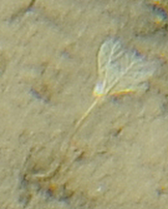
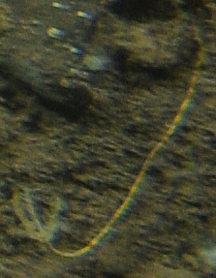
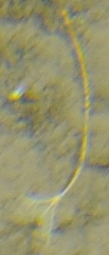
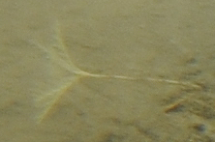
Order Bourgueticrinida
Bourgueticrinida (O.) sp. 1
White crinoid with at least four branching arms. Could be Conocrinus lofotensis (Sars, 1868; WoRMS)
Bourgueticrinida (O.) sp. 2
Yellow crinoid with at least 4 short arms. Hard to tell from orientation and very long yellow stalk.
Notes:
All stalked crinoids fall under the Order Bourgueticrinida

Slide 3
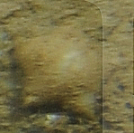
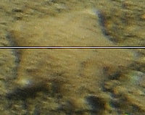
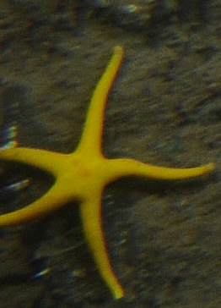
Henricia sp. 1
Yellow with 5 slender arms that curl upward at the tips.
Asteroidea (C.) sp. 1
Short-rayed sea star with robust central disc and 5 arms that are short relative to central disc. Mostly sediment coloured with the tips of the arms slightly lighter in colour. Could be a Pteraster.

Slide 4
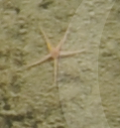
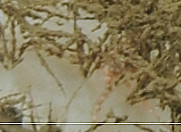
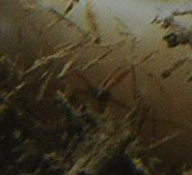
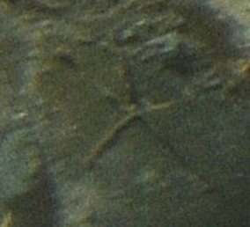
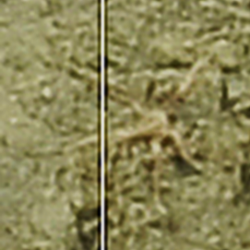
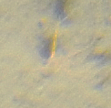
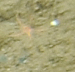
Class Ophiuroidea
Ophiuroidea (C.) sp. 3
Long red and white striped arms, darker red than Ophiuroidea (C.) sp. 1 and 2, on Vazella pourtalesi. Disk small relative to arm length.
Ophiuroidea (C.) sp. 1
Redish, small disk relative to arm length.
Ophiuroidea (C.) sp. 4
Dark small disk relative to arm length. Redish arms, located on Vazella pourtalesi.
Ophiuroidea (C.) sp. 6
Small dark brittle star 5 long thin arms and a small disk.
Ophiuroidea (C.) sp. 8
Small ophiuroid with 5 white and red banded arms and a small disk.
Ophiuroidea_buried

Slide 5
Heterokontophyta

Slide 6
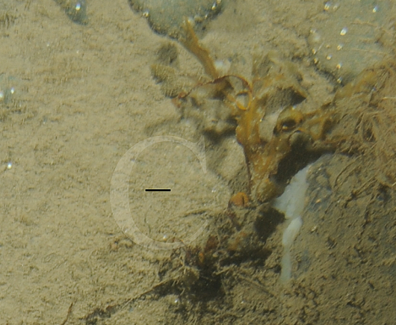
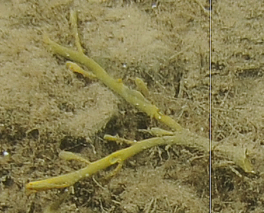
Heterokontophyta (P.) sp. 1
Green stalk, dichotomous branching and leaf-like protrusions. Likely a branch broken off from Ascophyllum.
Heterokontophyta (P.) sp. 2
Thin brown stem and large dichotomously branching brown leaf with air bladders. Likely broken off from Fucus.
These can be recorded but not included in any analysis.
They are dead and not benthos.

Slide 7
Mollusca

Slide 8
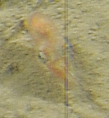
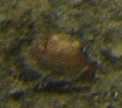
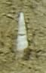
Bivalvia (C.) sp. 2
Bivalve with a rounded-triangular shape, growth rings concentric with lighter umbo. Redish-brown in colour.
Gastropoda (C.) sp. 1
Long, narrow, white shell with many whorls.
Cephalopoda (C.) sp. 1
Either Octopod or Squid

Slide 9
Nemertea

Slide 10
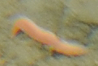
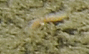
Nemertea (P.) sp. 2
Orange short and thin worm.
Nemertea (P.) sp. 1
Redish-pink relatively short and thick worm.

Slide 11
Porifera

Slide 12
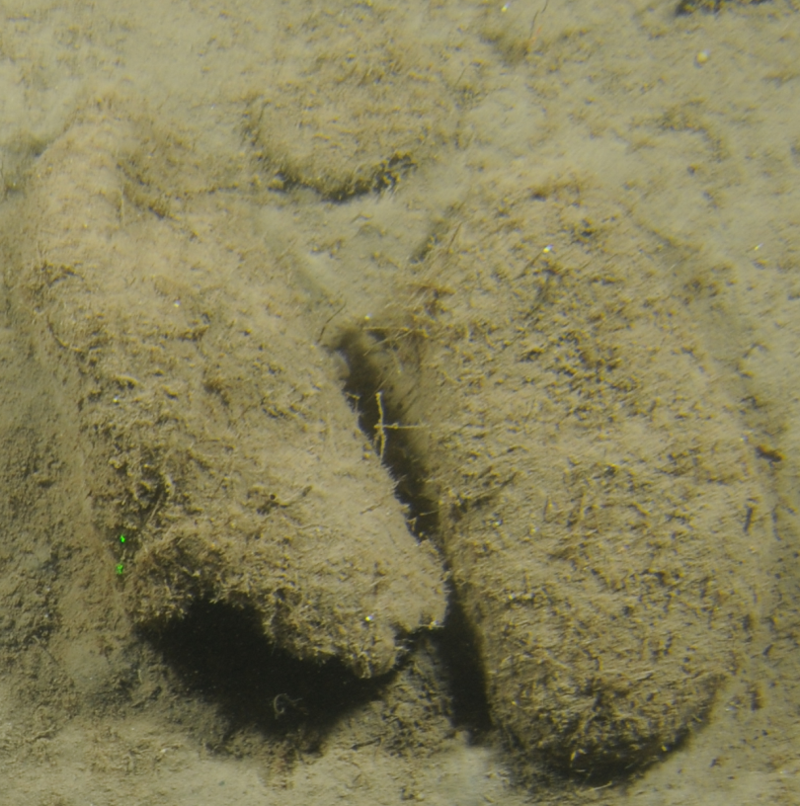
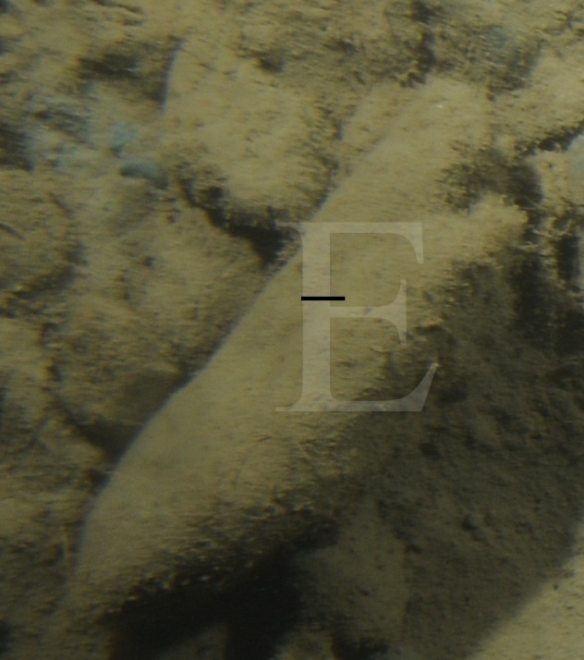
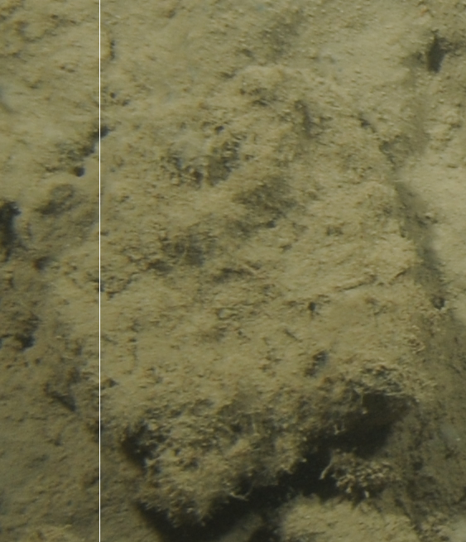
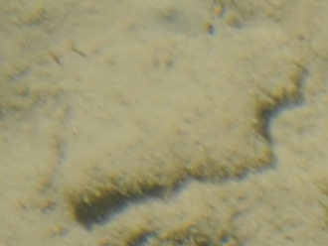
Vazella pourtalesi_dead
Vase or barrel shaped, sediment covered with spicule-like protrusions, can be flattened or deflated
Not considered dead Vazella pourtalesi

Slide 13
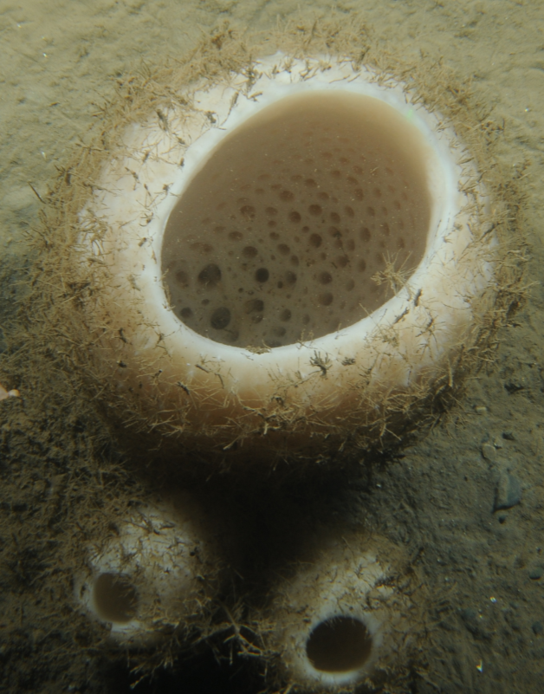
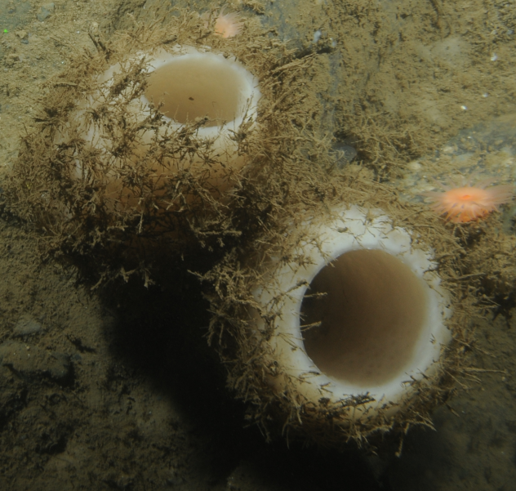
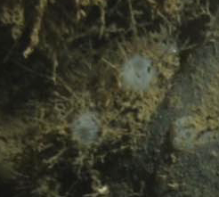
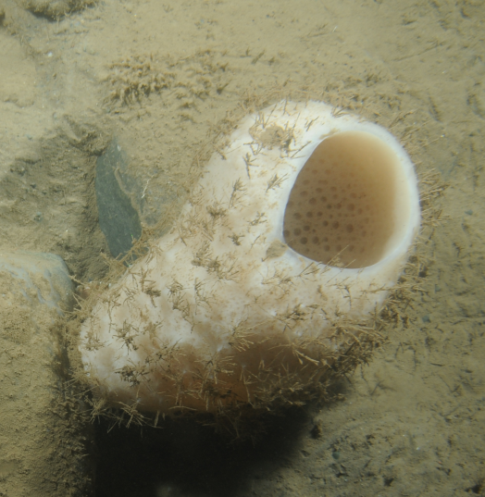
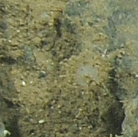
Vazella pourtalesi_live
White vase or barrel-shaped sponge with long spicules protruding from it.

Slide 14
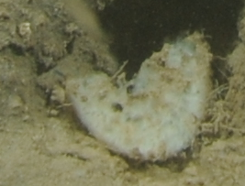
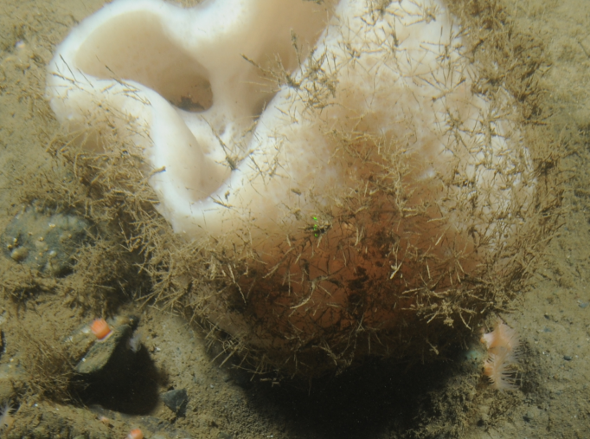
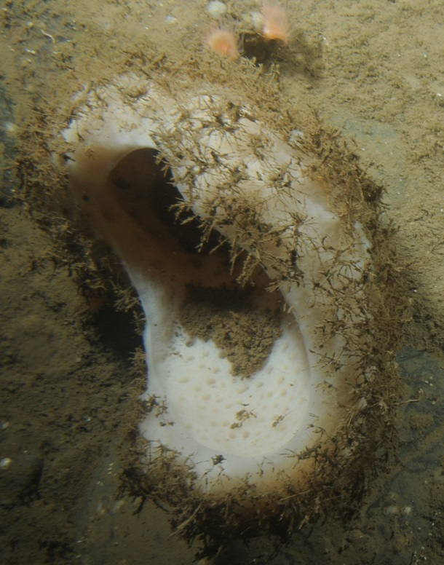
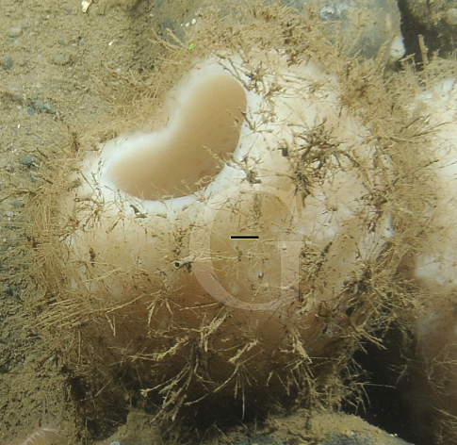
Vazella pourtalesi_damage
Can be torn, misshapen, stretched and/or flattened.

Slide 15
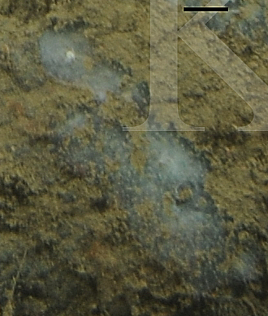
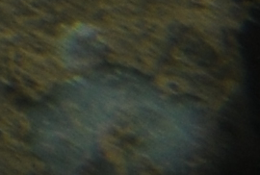
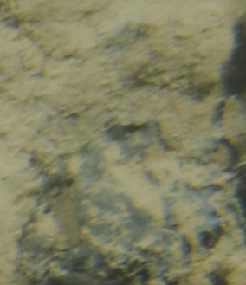
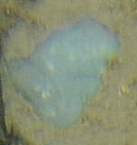
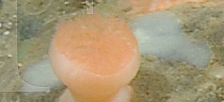
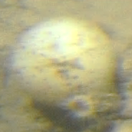
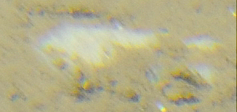
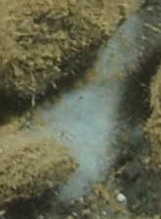
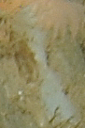
Porifera (P.) sp. 1
Thin encrusting sponge, grey-translucent
I think this is a rock
Porifera (P.) sp. 3
White spherical sponge. Could be a Geodia.
Porifera (P.) sp. 2
Cloudy opaque white encrusting sponge.
Notes:
Encrusting porifera: not every rock, only if there’s a definite edge and if there’s a good amount, not just a few scraps.
Porifera sp. 1: translucent/light grey
Porifera sp. 10: dark-medium green
Porifera sp. 20: light green/blue
Porifera sp. 22: opaque medium-dark grey

Slide 16
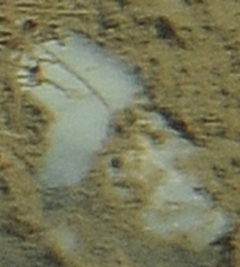
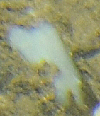
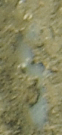
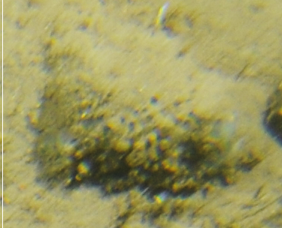
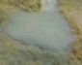
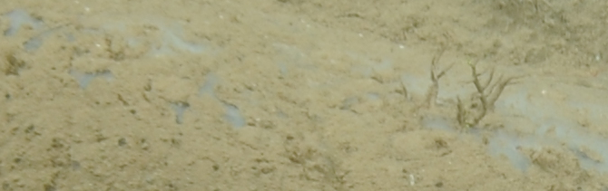
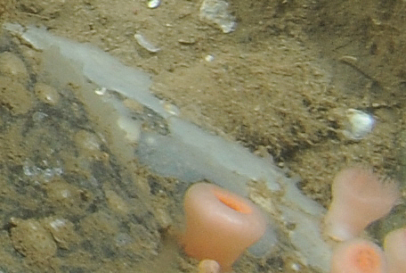





Porifera (P.) sp. 5
Sediment covered sponge. Could be dead Vazella pourtalesi.
Porifera (P.) sp. 4
Opaque white sponge. Oscula sometimes visible.
Porifera (P.) sp. 7
Cloudy white sponge with large, flat oscula seen. Sometimes partially covered in sediment.
Porifera (P.) sp. 6
Purple sponge on rock.
Not sure if this is a sponge. Unidentified.
The last three are hymedesmiids

Slide 17












Porifera (P.) sp. 12
Grey bumpy textured encrusting sponge. Small oscula sometimes visible. Could be a Hymesdesmiidae from a side angle.
Porifera (P.) sp. 8
White slightly raised sponge on rock. Small oscula seen.
Porifera (P.) sp. 13
White raised sponge on rock with a few larger oscula and many smaller oscula.
This is possibly Didemnidae, a colonial tunicate.

Slide 18







Porifera (P.) sp. 14
Yellow slightly raised sponge on rock with one large oscula.
Porifera (P.) sp. 16
White-grey globular sponge with a slight starburst on top. Many oscula of varying size visible with raised edges?
Porifera (P.) sp. 17
Thin, sediment coloured encrusting sponge with visible ocula.
Same as Porifera sp. 5
Porifera (P.) sp. 19
White sponge with many large oscula seen. Right part looks to be attached, but covered by more sediment. Could be seeing the inside of a very damaged Vazella.
I think this is Vazella!
Porifera (P.) sp. 21
White encrusting sponge on rock with visible oscula and a green tinge.

Slide 19








Porifera (P.) sp. 22
Grey opaque thin encrusting sponge with small oscula often visible.
Porifera (P.) sp. 23
Cushion grey encrusting sponge. Surface is appears slightly dappled or bumpy.
Porifera (P.) sp. 26
White globular sponge found in a clump of dead Vazella pourtalesi, but likely not one because of lack of spicules. A few oscula are visible.
Porifera (P.) sp. 28
Flat yellow encrusting sponge on rock.
Porifera (P.) sp. 25
Slightly raised smooth white sponge on rock. A few small oscula seen.

Slide 20











Porifera (P.) sp. 31
Semi-translucent sponge attached to rock. Slight white speckles with visible large osculum. Could be same as unidentified 128, but not sure.
Porifera (P.) sp. 30
Blue encrusting sponge. Dark dots appear to be oscula. One white spot clearly visible.
Porifera (P.) sp. 29
Sediment covered, encrusting sponge. A few large oscula visible.
Porifera (P.) sp. 33
White raised sponge with small oscula visible.
Porifera (P.) sp. 32
White semi-translucent sponge with white speckles. Small oscula seen.
Notes:
Porifera sp. 38 similar to Porifera sp. 57 and Porifera sp. 231 in tech report

Slide 21










Porifera (P.) sp. 38
Thin sheet encrusting on rock. Surface appears verrucose (warty). Pale green-blue in colour.
Porifera (P.) sp. 36
White cone-shaped sponge with an indent in the middle. *Gabrielle thinks it might be a demosponge
Porifera (P.) sp. 37
Pale blue globular or cushion sponge partially covered in sediment.
Porifera (P.) sp. 41
Yellow sponge. Partially cut off.
Porifera (P.) sp. 39
White sponge. Surface conulated, with large spicules protruding from cones. No visible osculae.
Porifera (P.) sp. 40
White to tan globular sponge. Sometime partially covered with sediment. A few small oscula may be visible.

Slide 22














Porifera (P.) sp. 43
Grey/off-white cushion, encrusting sponge. Smooth surface with a few oscula visible.
Porifera (P.) sp. 42
White opaque sponge with an osculum that is slightly more transparent and appears to be “chimney” shaped.
Porifera (P.) sp. 44
White semi-translucent flat encrusting sponge. Very defined edge. Whiter and less translucent than Porifera sp. 1 and less cloudy than Porifera sp. 2
Porifera (P.) sp. 45
White irregular-shaped encrusting cushion sponge with a bumpy surface. Small oscula dot the surface.
Porifera (P.) sp. 46
Bright orange encrusting sponge with visible oscula. Possibly a hymedesmiidae.

Slide 23












Family Hymedesmiidae
Hymedesmiidae (F.) sp. 1
Bright or pale, teal or green-blue in colour. Cushion encrusting to globular sponge on rock. Surface covered in large circular pore sieves with raised edges. Some may be in the process of closing or closed.

Slide 24











Hymedesmiidae (F.) sp. 2
White to blueish grey cushion encrusting sponge. Large circular pore sieves with raised edges. Appears to have starburst-like pattern on it.
Hymedesmiidae (F.) sp. 3
Irregularly shaped globular sponge. White in colour with pale blue pore sieves with raised edges, on soft sediment.
This one on the right is
Hymedesmiidae sp. 1
Hymedesmiidae (F.) sp. 4
White in colour. Cushion, encrusting sponge on rock. Often partially sediment covered. Surface covered in large circular pore sieves with raised edges.

Slide 25

Polymastia sp. 1
Partially buried, relatively large green papilla with purple tips.

